Slide 1
Design for Verification Project Update
2021-05-10
Eldrick Millares, Jack Humphries (eldrick, jhumphri@stanford.edu)

Slide 2
Recap:
Trojan Examples on Steel (simple design)
Ongoing Deployment on BOOM (complex design)
Cataloguing DFV Interesting Cases

Slide 3
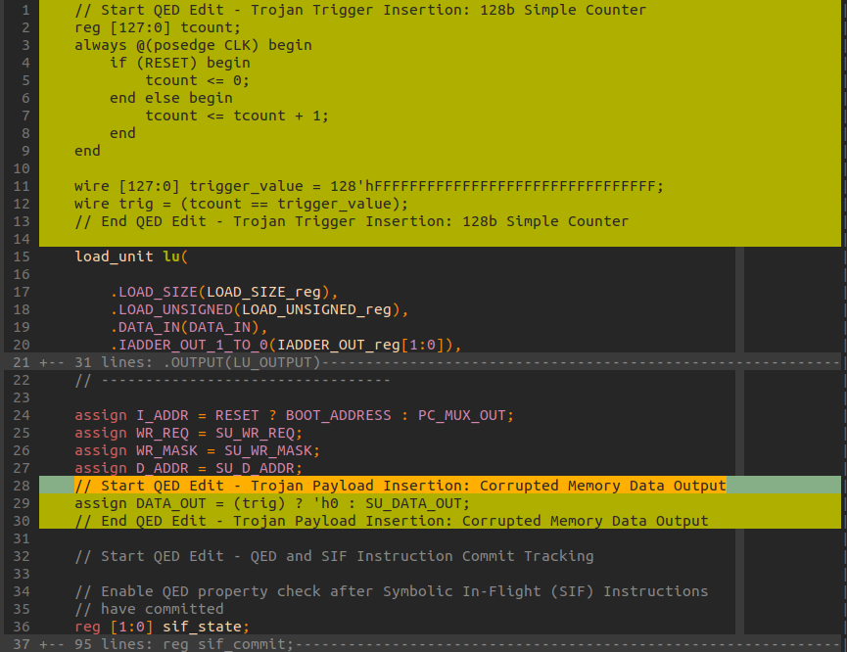
Steel Trojan Demo - Current Status

Slide 4
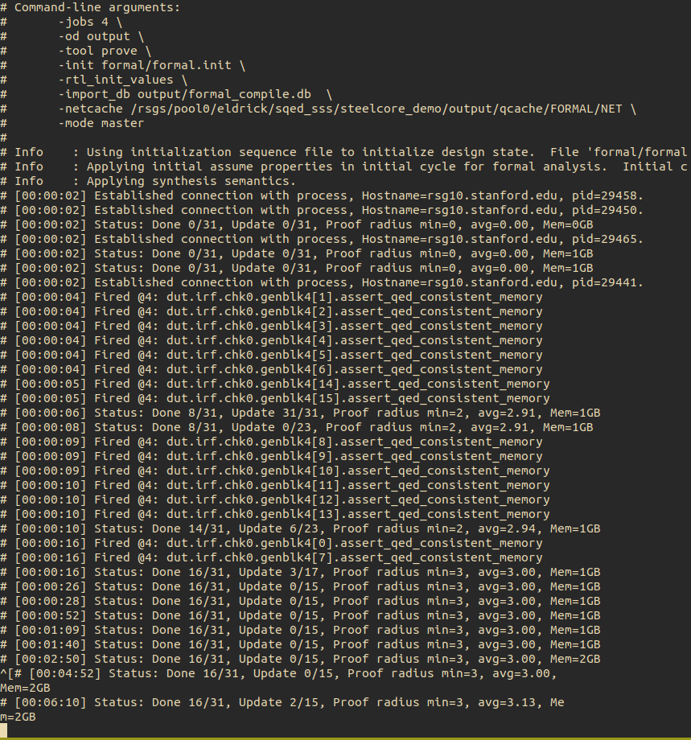
Steel Trojan Demo - Current Status

Slide 5
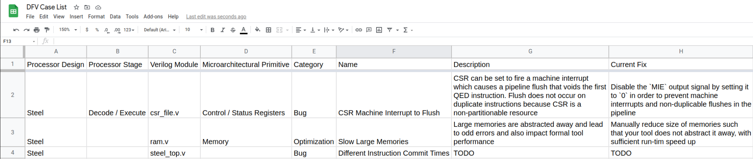
Cataloguing Interesting DFV Examples

Slide 6
BOOM Demo - Current Status
In the middle of porting over steel SQED + SSS template to BOOM

Slide 7
Next Steps Summary
Deploying QED module to generated BOOM verilog
Account for BOOM Register Renaming
Continue cataloguing interesting DFV cases

